Slide 1
Chapter 16
Exceptions

Slide 2
List of contents
Errors in a Python Program
Compile-Time Errors
Runtime Errors
Logical Errors
Exceptions
Exception Handling
Types of Exceptions
The Except Block
The assert Statement
User-Defined Exceptions
Logging the Exceptions

Slide 3
Introduction
As human beings, we commit several errors. A software developer is also a human being and hence prone to commit errors either in the design of the software or in writing the code.
The errors in the software are called 'bugs' and the process of removing them is called 'debugging'.
Let's learn about different types of errors that can occur in a program.

Slide 4
Errors in a Python Program
In general, we can classify errors in a program into one of these three types:
Compile-time errors
Runtime errors
Logical errors

Slide 5
Compile-Time Errors
These are syntactical errors found in the code, due to which a program fails to compile.
For example, forgetting a colon in the statements like if, while, for, def, etc. will result in compile-time error. Such errors are detected by Python compiler and the line number along with error description is displayed by the Python compiler.
Let's see Program 1 to understand this better. In this program, we have forgotten to write colon in the if statement, after the condition. This will raise SyntaxError.
We know that Python statements are written in blocks using proper indentation. The default number of spaces used for indentation is 4. All the statements belonging to the same block should use same number of spaces before them. If there is any deviation in the spaces, then we can see IndentationError raised by Python compiler. Consider Program 2 where we are using unequal number of spaces for the print statements inside the if statement.
Go to Jupyter notebook for examples
The Python compiler displays error message and the line number in case of compile-time errors. By checking the program source cede and rewriting the statements properly, we can eliminate the compile-time errors.

Slide 6
Runtime Errors
When PVM cannot execute the byte code, it flags runtime error. For example, insufficient memory to store something or inability of the PVM to execute some statement come under runtime errors. Runtime errors are not detected by the Python compiler. They are detected by the PVM, only at runtime.
In Program 3, we have written a function by the name ‘concat’ that accepts 2 arguments ‘a’ and ‘b’. It adds them using ‘+’ operator and displays the result. At the time of calling this function, if we pass two strings, they will be concatenated or joined. In this case, ‘+’ acts like concatenation operator. On the other hand, if we pass 2 numbers, then they are added and result is displayed. In this case, ‘+’ acts as addition operator. But, in the above example, we are passing one string and one number. Since the datatypes are not same, PVM shows ‘TypeError’. In Python, compiler will not check the datatypes. Type checking is done by PVM during runtime.
Program 4 is also an example for runtime error. In this program, we are creating a list with 4 elements. The indexes (or position numbers) of these elements will be from 0 to 3. When we refer to the index 4 which is not in the list, there will be IndexError during runtime.
Go to Jupyter notebook for examples

Slide 7
In case of runtime error, the PVM displays the line number and the type of error.
Most of the runtime errors can be eliminated by following the message given by PVM.
For example, in the previous program, restricting the list index below 4 is the solution to eliminate the runtime error. But some runtime errors cannot be eliminated. In that case, we should handle those errors using 'exception handling mechanism' of Python.
Logical Errors
These errors depict flaws in the logic of the program. The programmer might be using a wrong formula or the design of the program itself is wrong.
Logical errors are not detected either by Python compiler or PVM.
The programmer is solely responsible for them.
Go to Jupyter notebook for example

Slide 8
By comparing the output of a program with manually calculated results, a programmer can guess the presence of a logical error. In Program 5, we are using the following formula to calculate the incremented salary:
sal = sal * 15/100
This is wrong since this formula calculates only the increment but it is not adding it to the original salary. So, the correct formula would be:
sal = sal + sal * 15/100
Compile time errors and logical errors can be eliminated by the programmer by modifying the program source code. In case of runtime errors, when the programmer knows which type of error occurs, he has to handle them using exception handling mechanism. The runtime errors which can be handled by the programmer are called exceptions.
Before discussing exception handling mechanism, we will first understand what type of harm an exception can cause. Program 6 will help us in this regard.
Go to Jupyter notebook for example
What happens if we enter 10 and 0 as values for 'a' and to' in the previous program let us observe

Slide 9
When ‘ZeroDivisionError’ error occurred, PVM is simply displaying the error message and immediately terminating the program in line number 8. Due to this abnormal termination, the subsequent statements in the program are not executed. Hence, f.close() is not executed and the file which is opened in the beginning of the program is not closed. This leads to loss of entire data that is already present in the file. A file that is opened in any mode should be closed properly. This ensures safety for the data present in the file.
So, when there is an error in a program, due to its sudden termination, the following things can be suspected:
The important data in the files or databases used in the program may be lost.
The software may be corrupted.
The program abruptly terminates giving error message to the user making the user losing trust in the software.
Hence, it is the duty of the programmer to handle the errors. Please understand that we cannot handle all errors. We can handle only some types of errors which are called exceptions.

Slide 10
Exceptions
An exception is a runtime error which can be handled by the programmer. If the programmer cannot do anything in case of an error, then it is called an 'error' and not an exception
All exceptions are represented as classes in Python.
The exceptions which are already available in Python are called built-in exceptions.
The base class for all built-in exceptions is ‘BaseException’ class.
From BaseException class, the sub class 'Exception‘ is derived
From Exception class, the sub classes 'StandardError' and 'Warning' are derived.

Slide 11
All errors (or exceptions) are defined as sub classes of StandardError. An error should be compulsorily handled otherwise the program will not execute.
Similarly, all warnings are derived as sub classes from Warning' class. A warning represents a caution and even though it is not handled, the program will execute. So, warnings can be neglected but errors cannot be neglected.
Just like the exceptions which are already available in Python language, a programmer can also create his own exceptions, called 'user-defined' exceptions.
When the programmer wants to create his own exception class, he should derive his class from Exception class and not from 'BaseException' class.
In the next slide figure shows important classes available in Exception hierarchy

Slide 12
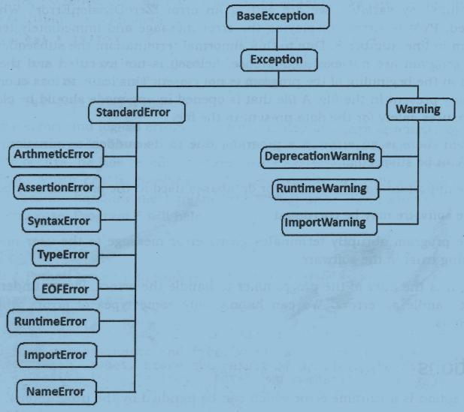

Slide 13
Exception Handling
The purpose of handling errors is to make the program robust. The word 'robust' means ‘strong’. A robust program does not terminate in the middle.
Also, when there is an error in the program, it will display an appropriate message to the user and continue execution. Designing such programs is needed in any software development. For this purpose, the programmer should handle the errors. When the errors can be handled, they are called exceptions.
To handle exceptions, the programmer should perform the following three steps:
Step 1: The programmer should observe the statements in his program where there may be a possibility of exceptions. Such statements should be written inside a ‘try’ block. A try block looks like as follows
try:
statements

Slide 14
Step 2: The programmer should write the 'except' block where he should display the exception details to the user. This helps the user to understand that there is some error in the program. The programmer should also display a message regarding what can be done to avoid this error. Except block looks like as follows:
except exceptionname:
statements # these statements form handler
Step 3: Lastly, the programmer should perform clean up actions like closing the files and terminating any other processes which are running. The programmer should write this code in the finally block. Finally block looks like as follows:
finally:
statements
Go to Jupyter notebook for example

Slide 15
In the previous discussion, we used try-catch-finally to handle the exception. However, the complete exception handling syntax will be in the following format:
try:
statements
except Exception1:
handler1
except Exception2:
handler2
else:
statements
finally:
statements
The `try' block contains the statements where there may be one or more exceptions. The subsequent 'except' blocks handle these exceptions. When 'Exception1' occurs, `handler1' statements are executed. When ‘Exception2’ occurs, ‘hanlder2’ statements are executed and so forth. If no exception is raised, the statements inside the 'else' block are executed. Even if the exception occurs or does not occur, the code inside 'finally' block is always executed.

Slide 16
The following points are noteworthy:
A single try block can be followed by several except blocks.
Multiple except blocks can be used to handle multiple exceptions.
We cannot write except blocks without a try block.
We can write a try block without any except blocks.
Else block and finally blocks are not compulsory.
When there is no exception, else block is executed after try block.
Finally block is always executed.

Slide 17
Types of Exceptions
There are several exceptions available as part of Python language that are called built-in exceptions.
In the same way, the programmer can also create his own exceptions called user-defined exceptions. The following Table summarizes some important built-in exceptions in Python.
Most of the exception class names end with the word 'Error'

Slide 18
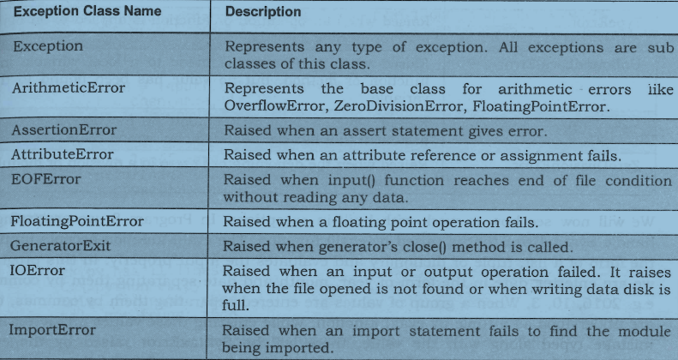

Slide 19
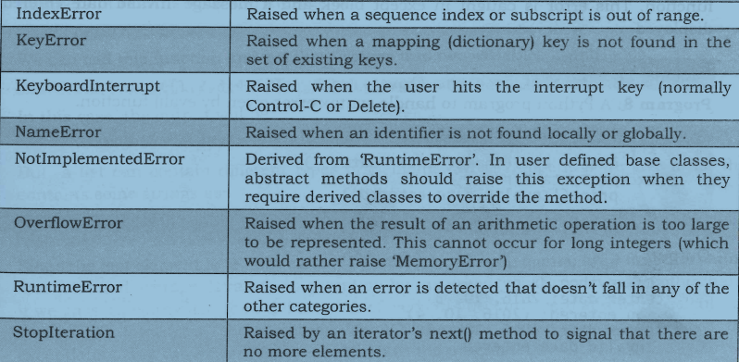

Slide 20
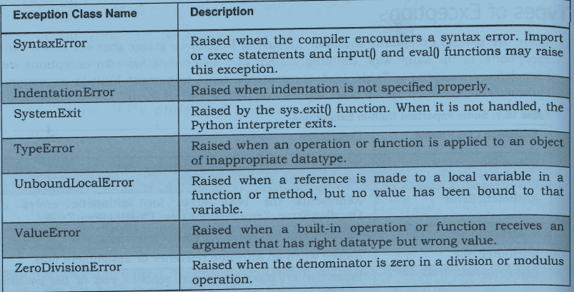

Slide 21
Now we will see how to work with built-in exceptions
Go to Jupyter notebook for examples

Slide 22
The Except Block
The 'except' block is useful to catch an exception that is raised in the try block. When there is an exception in the try block, then only the except block is executed. It is written in various formats.
1. To catch the exception which is raised in the try block, we can write except block with the Exceptionclass name as:
except Exceptionclass:
2. We can catch the exception as an object that contains some description about the exception.
except Exceptionclass as obj:
3. To catch multiple exceptions, we can write multiple catch blocks. The other way is to use a single except block and write all the exceptions as a tuple inside parentheses as:
except (Exceptionclassl, Exceptionclass2, ):

Slide 23
4. To catch any type of exception where we are not bothered about which type of exception it is, we can write except block without mentioning any Exceptionclass name as:
except:
In Program 11, we are finding inverse of a given number. In this program, we are using try block without except block. When we want to use try block alone, we need to follow it with a finally block. Since we are not using except block, it is not possible to catch the exception.
Go to Jupyter notebook for example

Slide 24
The assert Statement
The assert statement is useful to ensure that a given condition is True. If it is not true, it raises AssertionError.
The syntax is as follows:
assert condition, message
If the condition is False, then the exception by the name AssertionError is raised along with the 'message' written in the assert statement. If 'message' is not given in the assert statement, and the condition is False, then also AssertionError is raised without message.
Go to Jupyter notebook for example

Slide 25
The same program can be rewritten using a message after the condition in the assert statement. When the condition is False, the message is passed to AssertionError object ‘obj’ that can be displayed in the except block as shown in Program 13
Go to Jupyter notebook for example

Slide 26
User-Defined Exceptions
Like the built-in exceptions of Python, the programmer can also create his own exceptions which are called 'User- defined exceptions' or 'Custom exceptions'.
We know Python offers many exceptions which will raise in different contexts. For example, when a number is divided by zero, the ZeroDivisionError is raised. Similarly, when the datatype is not correct, TypeErroris raised.
But, there may be some situations where none of the exceptions in Python are useful for the programmer. In that case, the programmer has to create his own exception and raise it.
For example, let's take a bank where customers have accounts. Each account is characterized by customer name and balance amount. The rule of the bank is that every customer should keep minimum Rs. 2000.00 as balance amount in his account. The programmer now given a task to check the accounts to know every customer is maintaining minimum balance of Rs. 2000.00 or not. If the balance amount is below Rs. 2000.00, then the programmer wants to raise an exception saying 'Balance amount is less in the account of so and so person'. This will be helpful to the bank authorities to find out the customer.

Slide 27
So, the programmer wants an exception that is raised when the balance amount in an account is less than Rs 2000.00. Since there is no such exception available in Python, the programmer has to create his own exception.
For this purpose, he has to follow these steps:
1. Since all exceptions are classes, the programmer is supposed to create his own exception as a class. Also, he should make his class as a sub class to the in-built `Exception' class.
class MyException(Exception):
def __init__(self, arg):
self.msg = arg
Here, `MyException' class is the sub class for 'Exception' class. This class has a constructor where a variable `msg' is defined. This `msg' receives a message passed from outside through `arg'.
2. The programmer can write his code; maybe it represents a group of statements or a function. When the programmer suspects the possibility of exception, he should raise his own exception using 'raise' statement as:
raise MyException('message')
Here, raise statement is raising MyException class object that contains the given `message'.
3. The programmer can insert the code inside a 'try' block and catch the exception using ‘except’ block as:
try:
code
except MyException as me:
print(me)
Here, the object 'me' contains the message given in the raise statement.
All these steps are shown in Program 14
Go to Jupyter notebook for example

Slide 28
Logging the Exceptions
It is a good idea to store all the error messages raised by a program into a file.
The file which stores the messages, especially of errors or exceptions is called a 'log' file and this technique is called 'logging'.
When we store the messages into a log file, we can open the file and read it or take a print out of the file later. This helps the programmers to understand how many errors are there, the names of those errors and where they are occurring in the program.
This information will enable them to pin point the errors and also rectify them easily. So, logging helps in debugging the programs.
Python provides a module 'logging' that is useful to create a log file that can store all error messages that may occur while executing a program.
There may be different levels of error messages. For example, an error that crashes the system should be given more importance than an error that merely displays a warning message. So, depending on the seriousness of the error, they are classified into 6 levels in 'logging' module, as shown in following Table

Slide 29
Level | Numeric value | Description
CRITICAL | 50 | Represents a very serious error that needs high attention.
 | 40
ERROR |  | Represents a serious error.
WARNING |  | Represents a warning message, some caution is needed.
 | 30
INFO | 20 | Represents a message with some important information.
DEBUG | 10 | Represents a message with debugging information.
NOTSET | 0 | Represents that the level is not set.

Slide 30
As we know, by default, the error messages that occur at the time of executing a program are displayed on the user's monitor. Only the messages which are equal to or above the level of a WARNING are displayed. That means WARNINGS, ERRORS and CRITICAL ERRORS are displayed. It is possible that we can set this default behavior as we need.
To understand different levels of logging messages, we are going to write a Python program.
Go to Jupyter notebook for examples

